Slide 1

Lesson no 6
Airborne Electronic Warfare systems

Slide 2
01. Radar Warning Receiver (RWR)
02. Missile Warning Receiver (MWR)
03. Laser Warning Receiver (LWR)
04. RF Self-Protection Jammer (SPJ)
CONTENTS
05. Towed Decoy System
06. Active Infrared Countermeasures
Systems
07. Countermeasures Dispensing
Systems

Slide 3
01. Radar Warning Receiver
(RWR)

Slide 4
An RWR system is designed to provide a picture of the electronic order of battle
(EOB) operating in the vicinity of an aircraft.

Slide 11
02. Missile Warning Receiver
(MWR)

Slide 12
Missile Warning Systems (MWS) are designed to detect missile launches, warning aircrew of this threat and cueing countermeasure employment.
Missile Warning Systems (MWS) are designed to detect these missile launches and,
in the case of the MWS sub-categories
Missile Approach Warners (MAW) and
Missile Launch and Approach Warners (MLAW),
their approach.

Slide 13
There are three types of MWS technology:
• Active RF – Pulsed Doppler (RF-PD), (ALQ-156);
• IR, (DDM-Prime);
• UV, (AAR-54(V).

Slide 16
03. Laser Warning Receiver
(LWR)

Slide 17
LWS consist of sensors to detect the laser signal, a processor to analyze the data, and a mechanism to warn the pilot.
Laser detectors are commonly integrated with the sensor modules of MWS and often share a common processor. Typically, 6 – 8 sensors are required to provide spherical coverage.

Slide 19
04. RF Self-Protection Jammer
(SPJ)

Slide 20
Self-protection jamming systems are designed to counter
surface-to-air missile (SAM),
airborne interceptor (AI), and
antiaircraft artillery (AAA) acquisition and
target tracking radars.
Self-protection jamming systems generate noise and deception jamming techniques to either deny threat system automatic tracking capability or generate sufficient tracking errors to prevent a successful engagement.

Slide 22
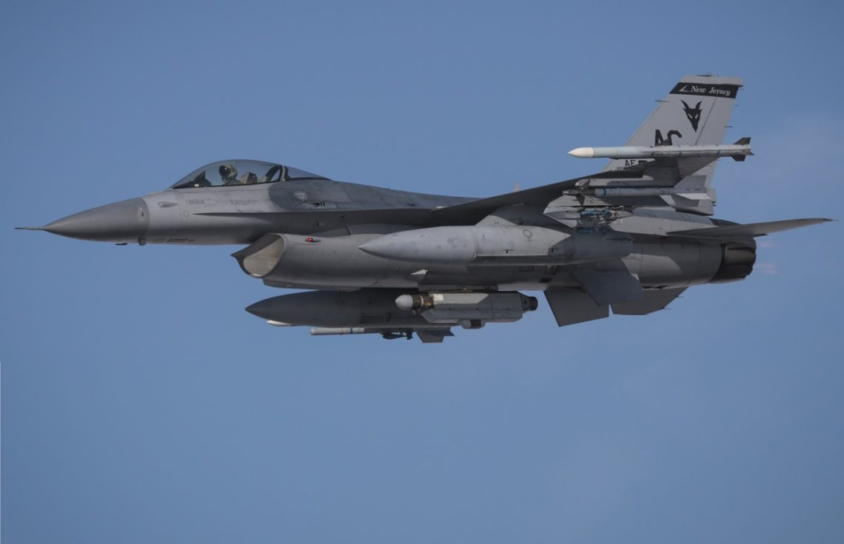

Slide 23
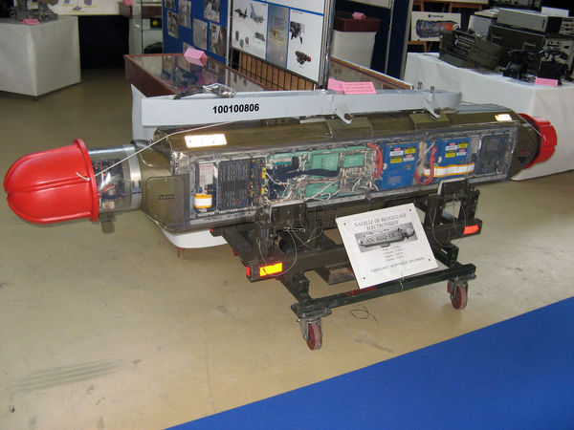

Slide 24
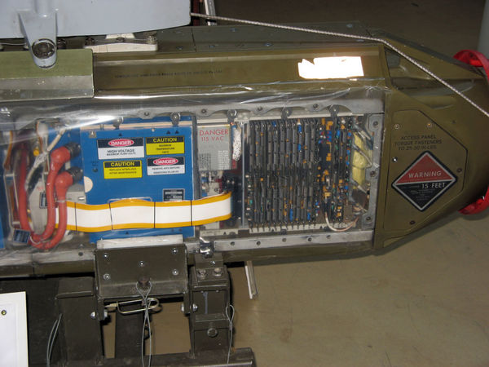
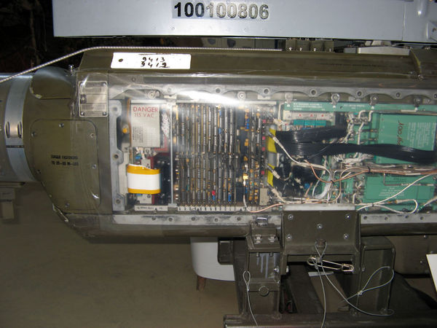
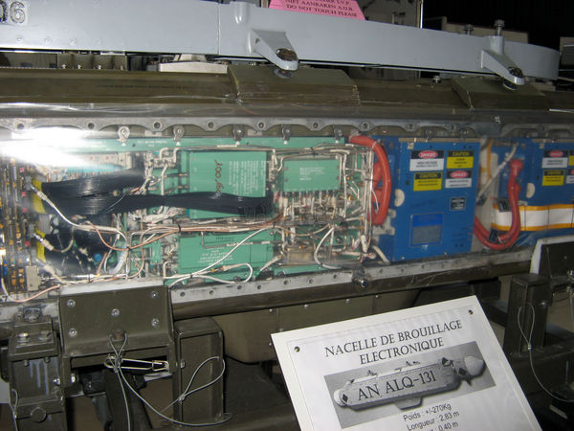

Slide 25
04. Towed Decoy System

Slide 26
Radio frequency towed decoys are defensive EA systems performing self-protection jamming.
They differ from onboard SPJ in that they are countermeasures systems dispensed from the host aircraft either pre-emptively or automatically in response to a hostile radar threat engagement.
They are towed behind the aircraft and designed to present a more seductive target to the hostile radar or missile seeker.

Slide 27
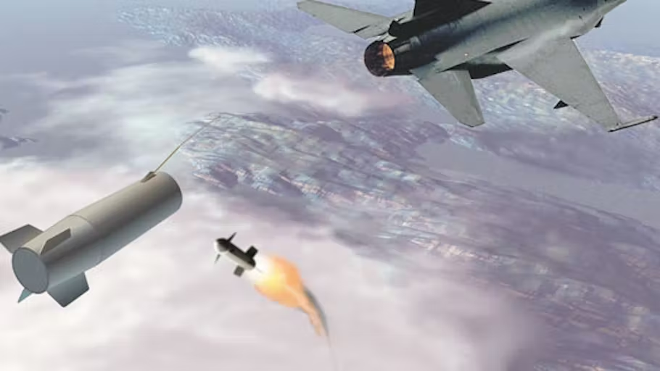

Slide 28
06.Active Infrared Countermeasures
Systems

Slide 29
Conventional active IRCM systems are electrically powered defensive EA systems designed to protect aircraft from IR-guided missiles.
There are several types of IRCM systems.
The simplest is a ‘turn on and forget’ system that uses a modulated IR jamming waveform that transmits continuously over its field of view.

Slide 30
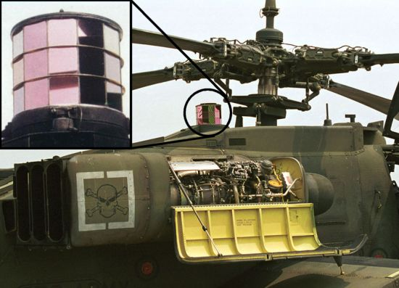

Slide 31
More sophisticated IRCM systems, often called Directed IRCM (DIRCM) systems, are turret mounted and receive cuing information from MWS.
These systems typically use either arc-lamp or laser-generated AM jamming waveforms.
Laser-based systems have the advantage of directing significantly more energy into the victim missile seeker.

Slide 32
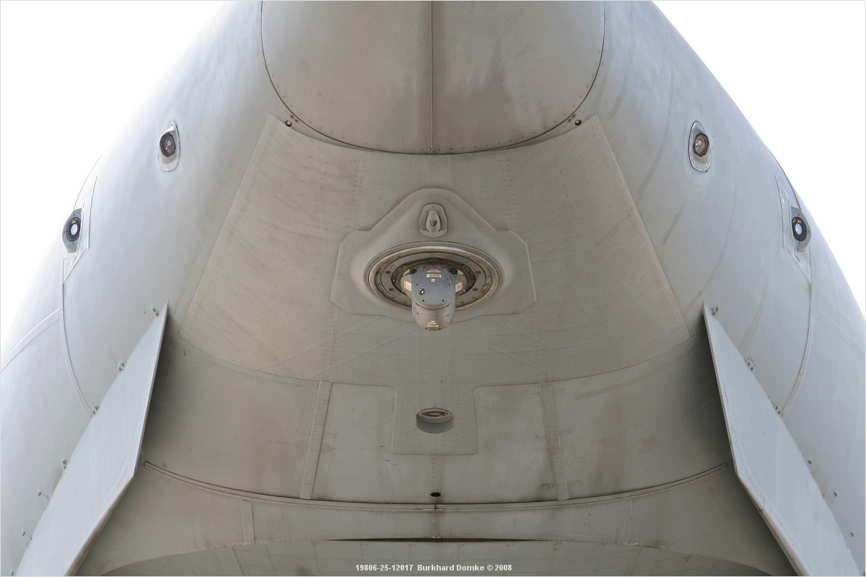

Slide 33
07. Countermeasures Dispensing
Systems

Slide 34
CMDS are most employed in a defensive electronic attack role. They dispense expendable payloads to deceive hostile air defense weapons systems. Conventional chaff and flares are the most common payloads.
Chaff is one of the oldest forms of radar electronic countermeasures. It consists of a large number of microfibre reflective dipoles.
When dispensed it disperses in the air stream forming a cloud and presenting the hostile radar with other competing large RCS targets.

Slide 36
Flares are pyrotechnic devices designed to deceive IR-guided missiles by presenting the missile seeker with a more attractive target than that the target aircraft.
Conventional flares are made of various combinations of magnesium, phosphorus, and Teflon which is ignited when the flare is dispensed from the magazine and tries to mimic relevant spectral aircraft engine characteristics.

Slide 38
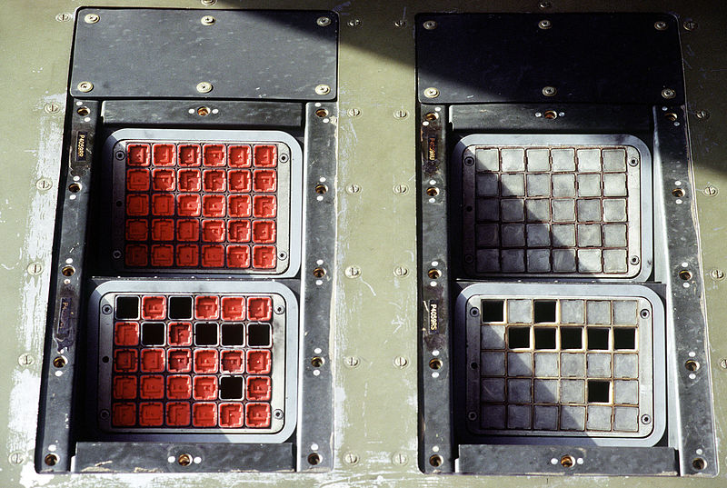

Slide 39
Thanks

